Slide 1
Chapter 2 (Software engineering)

Slide 2
1. Process, Methods, and Tools in Software Engineering
Software engineering is like constructing a building. It has layers of technology that work together to create reliable software. These layers are held up by three main ideas: process, methods, and tools
1. Quality Focus (Foundation)
The foundation of software engineering is a strong focus on quality. This means ensuring that everything done is reliable and meets a high standard. Quality is at the base of everything in software engineering.
2. Process
The process layer is what connects all parts of software engineering and keeps things organized. Think of it as the glue that binds all tasks together.

Slide 3
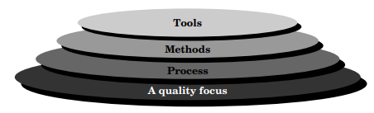
3. Method
Methods tell us how to build software. They are the practical steps for getting the job done. This layer includes:
Understanding what the software needs to do (requirements analysis).
Designing how it will look and function (design).
Writing the code (program construction).
Checking for errors (testing).
Supporting the software after it’s built (support).
4. Tools Layer
The tools are special programs that help us carry out processes and methods more easily. When these tools work together, they create a complete environment for software development, known as computer-aided software engineering (CASE). CASE combines software and hardware tools to support every step of creating software.

Slide 4
2.Support phase of software maintenance involves making changes for four main reasons:
Correction: Fixing defects or bugs found after release.
Adaptation: Updating software to fit new environments, like changes in hardware, OS, or business rules.
Enhancement: Adding new features or improvements based on user needs.
Prevention: Reengineering software to keep it stable and maintainable, making future updates easier.
These changes ensure the software remains effective and relevant over time.

Slide 5
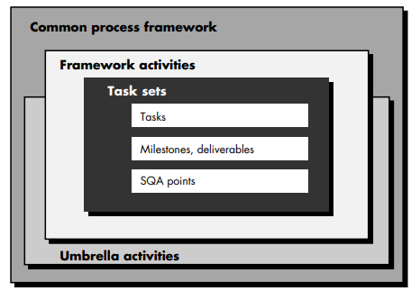
3.THE SOFTWARE PROCESS
This is like a plan or roadmap that helps teams create software in a structured way. It’s a set of steps and activities that everyone follows.
Framework Activities: These are the main steps everyone follows in any software project, like planning, designing, coding, and testing. Think of them as the basic “ingredients” in any project.
Task Sets: These are collections of specific tasks, goals, and quality checks for each step in the process.
Umbrella Activities: These are tasks that support the entire project, like making sure the software is high quality and keeping track of different versions of the code. They run throughout the project, helping everything stay organized and on track.

Slide 6
Process Maturity Levels :-
Process maturity measures how organized and efficient a company’s software development is. The SEI has created five levels of maturity:
Level 1 - Initial: Things are done on the fly, with no clear structure; success relies heavily on individuals.
Level 2 - Repeatable: Basic processes are in place to manage cost, time, and features, helping repeat past successes.
Level 3 - Defined: Processes are standardized and documented across the company, so all projects follow the same steps.
Level 4 - Managed: The company tracks data on their processes and product quality to stay in control and keep things consistent.
Level 5 - Optimizing: The company constantly improves its process using data and tries out new ideas to make things better.
Each level builds on the last, bringing more order and efficiency to the way software is created.

Slide 7
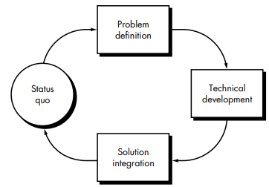
4.SOFTWARE PROCESS MODELS
In software engineering, a process model is the approach used to organize and manage the work of creating software. It includes planning, methods, tools, and different phases to ensure successful delivery.
Software development can be seen as a problem-solving loop:
Status Quo: The current state or situation.
Problem Definition: Defining the specific Problem to be solve.
Technical Development: Developing a solution using technology.
Solution Integration: Delivering the finished solution to users or clients.

Slide 8
1.THE LINEAR SEQUENTIAL MODEL:-
Sometimes called the classic life cycle or the waterfall model, the linear sequential model suggests a systematic, sequential approach to software development.
We have different phases in this model :-
1.System/Information Engineering and Modeling: This phase sets the foundation by defining what each part of the system will need to do and what will be handled by software specifically.
2.Software Requirements Analysis: Here, the software engineer (analyst) collects detailed requirements, like what the software must do (its functions), how it should perform, and how it will interact with users and other systems. These requirements are written down and reviewed with the customer to ensure everyone agrees on the software’s goals.
3.Design: This is a detailed planning phase where the software’s structure is organized. The design focuses on:
Data Structure: How data will be organized within the software.
Software Architecture: Defining how different parts will work together
Interface Representations: How users and other systems will interact with the software (GUI,CLI).
Procedures (Algorithms): The step-by-step instructions for the program's logic. This design becomes a blueprint for the software and is documented for reference and quality assessment before any coding begins.

Slide 9
4.Code Generation: This is the actual coding phase, where the design is translated into machine-readable code (the software)
5.Testing: Once the software is coded, it needs thorough testing. Testing ensures the software’s internal logic works correctly and that it produces the correct outputs based on specific inputs.
6.Support: After the software is delivered, it enters the support (or maintenance) phase. Software often needs updates over time, whether due to:
Bug Fixes: Correcting issues discovered after release.
Adaptations: Adjusting the software to work with new operating systems or hardware.
Enhancements: Adding new features or improving performance. Maintenance applies the same phases as new development (requirements, design, coding, etc.) but focuses on an existing program rather than building from scratch.

Slide 10
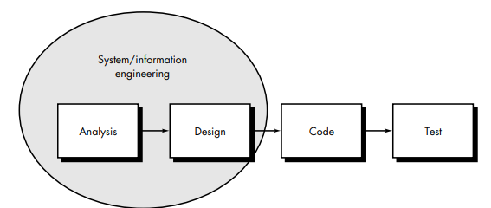
The linear sequential model is the oldest and the most widely used paradigm for software engineering.
Real projects rarely follow the sequential flow.
It is often difficult for the customer to state all requirements explicitly.
The customer must have patience. A working version of the program(s) will not be available until late in the project time-span.
It provides a template.

Slide 11
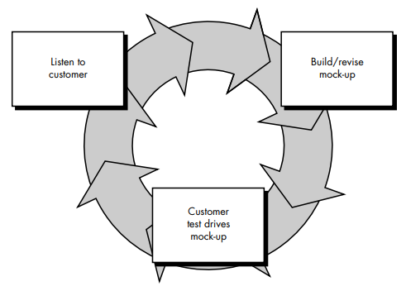
2.THE PROTOTYPING MODEL
The prototyping paradigm begins with requirements gathering. Developer and customer meet and define the overall objectives for the software.
A "quick design" then occurs. The quick design focuses on a representation of those aspects of the software that will be visible to the customer.
The quick design leads to the construction of a prototype. The prototype is evaluated by the customer/user and used to refine requirements for the software to be developed.
Iteration occurs as the prototype is tuned to satisfy the needs of the customer, while at the same time enabling the developer to better understand what needs to be done.

Slide 12
When to Use the Prototyping Model
The Prototyping Model is ideal when:
Requirements are not well understood .
Users need to "see" a working version to clarify their requirements.
There’s a need for quick feedback to minimize misunderstandings and rework.
Benefits
Helps in capturing user requirements accurately.
Provides early feedback, reducing the risk of major issues late in the development.
Drawbacks
Can lead to scope creep, where users keep requesting new features, extending development time.
The prototype can create unrealistic expectations, especially if users assume it’s close to the final product.
May increase development time and cost if multiple refinements are required.

Slide 13
3.THE RAD (Rapid application development) MODEL:-
It is an incremental software development process model that emphasizes an extremely short development cycle.
The RAD model is a “high-speed” adaptation of the “linear sequential model” in which rapid development is achieved by using component-based construction.
The RAD process enables a development team to create a “fully functional system” within very short time periods (e.g., 60 to 90 days).
the RAD approach encompasses the following phases :-
1.Business Modeling: This phase explores how information moves within the business:
It answers key questions about who produces information, who receives it, and where it goes.
2.Data Modeling: Here, the information identified in the previous phase is organized into "data objects" or entities.
Each data object represents something in the business (like "Customer" or "Order").
3.Process Modeling: This phase describes what we do with each “data object.”
This phase focuses on describing actions: adding, updating, or deleting data.
4.Application Generation: Now, instead of coding everything from scratch, RAD uses pre-built parts or makes parts that can be reused later. Automated tools help here, so you can build the application faster.
5.Testing and Turnover: Since we’re reusing parts that were already tested, there’s less to test from scratch.
Only new parts and connections need thorough testing, which saves time.

Slide 14
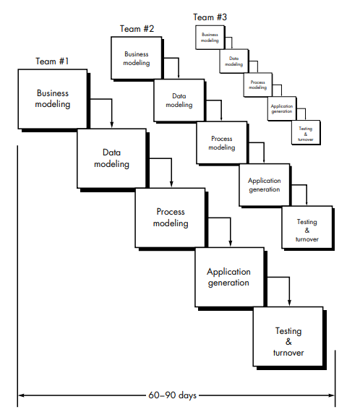

Slide 15
EVOLUTIONARY SOFTWARE PROCESS MODELS :-
main points about Evolutionary Software Process Models and why they’re useful:
Software Changes Over Time: Software is complex and changes are common during development, especially as requirements evolve or new ideas come up.
Adapting to Real Situations:
Changing Requirements: Business or customer needs can shift, so software developers need a model that can handle these changes.
Market Pressures: Companies may have tight deadlines to release a product, even if only a basic version, to keep up with competitors or meet business demands.
Evolutionary Models vs. Traditional Models:
The Linear Sequential Model (Waterfall Model) moves in a straight line, assuming all requirements are clear from the start and that development can proceed without going back.
The Prototyping Model helps clarify requirements by building a mock-up but isn’t aimed at creating the final product.
Evolutionary Models Are More Flexible: They’re designed for situations where software will evolve over time, making them better suited to handle change and gradual development.
5.Evolutionary models are iterative. They are characterized in a manner that enables software engineers to develop increasingly more complete versions of the software.

Slide 16
1. The Incremental Model :-
The Incremental Model is a flexible approach to building software in stages, with each stage (or "increment") adding more features or improvements. Here’s how it works:
1.Combining Linear and Iterative Approaches:
It mixes two methods: the Linear Sequential Model (a step-by-step approach) and Prototyping (building versions to refine based on feedback).
Each stage is a small, complete cycle that produces a part of the final product.
2.Building in Increments:
In each increment, a part of the product is developed and delivered.
For example, a word processor could be built incrementally:
Increment 1: Basic file management, editing, and document saving.
Increment 2: More advanced editing tools.
Increment 3: Spelling and grammar checking.
Increment 4: Advanced page layout features.
3.Starting with a Core Product:
The first increment often includes a core product with basic functions.
This core product is used or reviewed by the customer, who provides feedback.

Slide 17
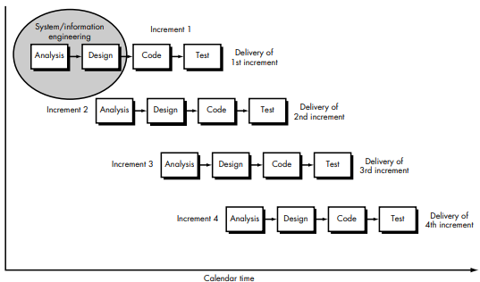
4.Feedback and Planning for the Next Increment:
After each increment, feedback is collected, which helps shape the next increment’s features and any necessary improvements to the core product.
This cycle of building, delivering, and refining repeats until the full product is complete.
5.Advantages:
The customer sees a working product early, and more features are added based on real use.
This model adapts to changing requirements as each increment refines and expands on the previous one.

Slide 18
2.The Spiral Model:-
The Spiral Model is a software development approach that combines elements of both design and prototyping in stages, while focusing heavily on risk assessment. This model is ideal for large, complex, and high-risk projects that may change over time.
Here’s how the Spiral Model works, broken down into simple terms:
Iterative Cycles (or Spirals):
The Spiral Model is a series of loops (or "spirals"), each representing a phase of the project.
Each loop includes planning, risk analysis, development, and evaluation.
Risk Analysis:
One of the main focuses of the Spiral Model is risk assessment. Before each phase begins, potential risks (such as time, cost, or technical issues) are carefully considered and analyzed.
If a risk seems high, extra effort is put into finding solutions before moving forward.
3.Four Main Phases in Each Spiral:
Planning: Goals, requirements, and alternatives are defined for the next stage.
Risk Analysis: Potential problems are identified, and plans are made to address them.
Engineering/Development: The actual software or prototype is built for that cycle.
Evaluation: The customer and stakeholders review the product and provide feedback.
4.Continuous Refinement:
After each spiral, the software is refined based on feedback, and the next loop begins.
Each cycle builds on the previous one, gradually improving and expanding the product.

Slide 19
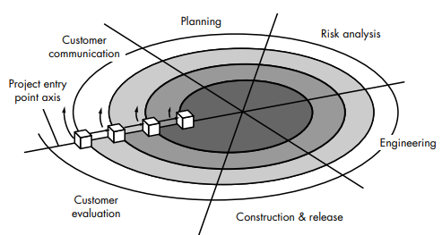
5.Final Product:
The Spiral Model ends when the product is complete and all risks are resolved.
Because of its iterative nature, the Spiral Model produces a progressively refined version of the software at each stage, leading to a well-tested final product.

